Slide 1
Further Data Structures
Data Structures Wk13
Time for some advanced data structures
Last few classes we studied
  Study how to adjust the size of arrays according to usage.
  A new way to analyze such data structures
  Data structure for searching in 2-d point sets
  Data structures for strings such as the list of contacts in a mobile phone
This week:
  Connect graphs with matrices and some interesting properties.
  Some ideas on what current practical graphs look like.

Slide 2
Graphs and Matrices
Data Structures Wk13
Today we will see an approach which views the graph as a matrix.
Matrix operations then map to graph operations, and vice-versa.
Called as algebraic graph theory.
We will see an application to the all pairs shortest paths problem.

Slide 3
Basic Observations
Data Structures Wk13
Recall matrix multiplication.
Consider two square matrices A and B of size nxn each.
The matrix C = AxB is defined as:
  C[i,j] = Σ_{k} A[i,k].B[k,j]

Slide 4
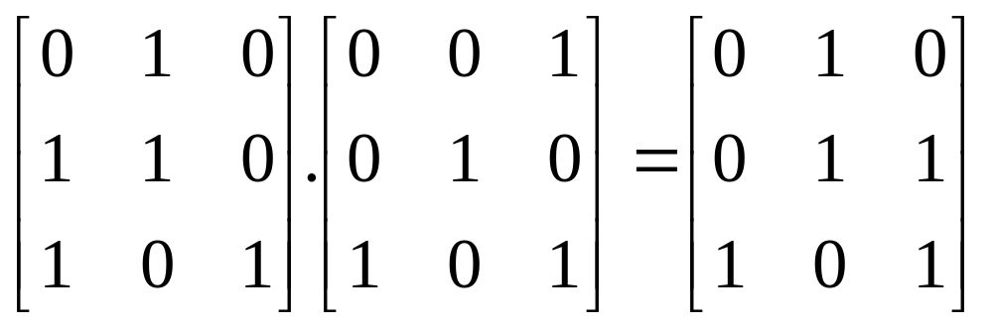
Basic Observations
Data Structures Wk13
Change the setting slightly:
  Boolean matrices : Entries are 0 or 1.
  Instead of multiply, take Boolean AND.
  Instead of addition, take Boolean OR.
  Example shown above.

Slide 5
Implications to Graphs
Data Structures Wk13
G
i
k
j
Consider a directed graph G = (V,E) represented by its adjacency matrix A.
The matrix A is a Boolean matrix.
Consider the matrix A² = AxA.

Slide 6
Implications to Graphs
Data Structures Wk13
G
i
k
j
When is A²[i,j] = 1?
  There is some index k such that A[i,k] = 1 and also A[k,j] = 1.
  In graph terms, vertices i and k are neighbors and vertices k and j are neighbors.
  Therefore, there is at least one path from i to j of length 2.

Slide 7
Implications to Graphs
Data Structures Wk13
G
i
k
j
Suppose we also modify A as:
  Make A[i,i] = 1 for each vertex (row) i.
  Then, A²[i,j] = 1 if and only if there is a path of length at most 2 between vertices i and j.

Slide 8
Further Extendible
Data Structures Wk13
By the same logic, A³ should be such that:
  A³[i, j] = 1 if and only if there is a path of length at most 3 between vertices i and j.
Extends all the way up to A^{n}.
Other applications of matrix based solutions:
  Number of spanning trees of a given graph G
  Number of matchings of a given graph G
  Random walks on graphs

Slide 9
Transitive Closure
Data Structures Wk13
Given a (directed) graph G = (V, E), for every vertex v, find the set of vertices reachable from v.
The notion of a closure is more mathematically well-defined.

Slide 10
Transitive Closure
Data Structures Wk13
Think of a matrix A_{T} of size nxn such that:
  A_{T} is a Boolean matrix.
  A_{T} [i,j] = 1 if and only if (i,j) is in the transitive closure.
  Notice that (i,j) is in the transitive closure if and only if there is a path of length at most n from i to j.
How to compute A_{T}?

Slide 11
Transitive Closure
Data Structures Wk13
Observe that A_{T} = A^{n}, with the diagonal elements of A set to 1.
Why?

Slide 12
Transitive Closure
Data Structures Wk13
Observe that A_{T} = A^{n}.
Why?
  By our observation earlier, A_{T}[i,j] = 1 if and only if there is a path of length at most n from i to j.
To compute A^{n}, multiply A with itself repeatedly.
Can do in O(n³ log n)
Why?

Slide 13
Transitive Closure
Data Structures Wk13
Observe that A_{T} = A^{n}.
Why?
  By our observation earlier, A_{T}[i,j] = 1 if and only if there is a path of length at most n from i to j.
To compute A^{n}, multiply A with itself repeatedly.
Can do in O(n³ log n)
Why?
  We see that A^{n} = A^{n/2}.A^{n/2}.
  Following this, can repeatedly square A.

Slide 14
Transitive Closure
Data Structures Wk13
Observe that A_{T} = A^{n}.
Why?
  By our observation earlier, A_{T}[i,j] = 1 if and only if there is a path of length at most n from i to j.
To compute A^{n}, multiply A with itself repeatedly.
Can do in O(n³ log n)
Why?
  We see that A^{n} = A^{n/2}.A^{n/2}.
  Following this, can repeatedly square A.
A highly parallel algorithm too.

Slide 15
Extension to Weighted Graphs
Data Structures Wk13
Suppose now that we have a weighted graph G = (V, E, W).
We want to find the shortest path between every pair of vertices.
Need to revise some of the above notions.

Slide 16
Extension to Weighted Graphs
Data Structures Wk13
Consider the graph A².
In the presence of multiple paths between vertices u and v, need to know the shortest.
Again, recall that A²[u,v] = Σ_{k} A[u,k] . A[k,v].
  In our setting for non-weighted graphs, multiplication is replaced by the Boolean AND
  Addition is replaced by Boolean OR.
How about weighted graphs?

Slide 17
Extension to Weighted Graphs
Data Structures Wk13
Instead of simply registering that there exists a k such that A[u,k] = 1 and A[k,v] = 1, need to know a k* such that
  A[u,k*] + A[k*,v] is minimized at k*.
Suggests that the AND operations should now be the sum operation.
Also, the OR operation earlier should now be the MIN operation.
In essence, A²[u,v] = min_{k} A[u,k] + A[k,v].

Slide 18
Extends to Larger Paths Too
Data Structures Wk13
Need to compute A^{n} so that:
  Multiplication is replaced by addition
  Addition is replaced by minimum.

Slide 19
Program
Data Structures Wk13
Algorithm APSP(G)
Begin
A = A(G);
for i = 1 to log n do
A = Multiply(A,A);
end
end

Slide 20
Further Improvements
Data Structures Wk13
The current approach has a runtime of O(n³ log n).
In fact, it holds that any matrix multiplication algorithm can be used.
The current best for matrix multiplication is O(n^{2.6})
A slightly different approach gives a runtime of O(n³).

Slide 21
Further Improvements
Data Structures Wk13
The above approach works well for dense graphs.
For sparse graphs, there may be too much space wastage.
  Especially in sparse directed graphs.
New approaches are still under study.

Slide 22
Graphs of Present Interest
Data Structures Wk13
Some recent applications of graphs in computing are:
  Maps and directions.
  Train/Airline connection maps
  Internet
  Citation networks
  Biological networks
  Social networks such as Facebook, Orkut
Some characteristics:
  Large size, typically millions of vertices
  But, very few edges. Average degree is less than 10.
  Some vertices however have a very large degree.

Slide 23
Graphs of Present Interest
Data Structures Wk13
New problems of recent interest
  Path problems.
    Intuitively, vertices of degree 1 do not contribute to much of the computation.
    Very few options at every node of low degree.
    So new approaches that adapt to the graph models are of interest
  Similar strategies can be thought of for other graph problems too such as spanning trees.

Slide 24
Graphs of Present Interest
Data Structures Wk13
Find metrics on a given network
  H-index
  Erdos number
  Impact factor of a journal/conference
Some of these were homework problems in HW4 and 5.
Graph mining
  Imagine a call graph
  What kind of calls are relevant for an investigation?
Find popular nodes in a network.
  Defined by some notion of popularity

Slide 25
Summary
Data Structures Wk13
Graphs play an important role in computing.
We have only touched upon on some of the classical problems and their early solutions.
Current solution properties opened up several new problems and new solution approaches.
Further courses:
  Algorithms : Flows in networks,
  Language processing : Paths in directed graphs, the Viterbi algorithm
  Advanced Algorithms : Random walks on graphs, parallel graph algorithms
  Graph Theory* : matchings, colorings, random graphs,

Slide 26
The Course Summary
Data Structures Wk13
Basic topics
  Arrays
  Linked lists
  Stacks and queues
Primarily ways to store data with applications to
  Settings where access order of data is relevant.
  Do not have any efficient search capability

Slide 27
The Course Summary
Data Structures Wk13
In the process of searching we found
  Hash tables with various extensions
  Binary search trees
  Balanced search trees
  Tries
  Range trees
  Heaps
  Splay trees
All the above have specific settings in which they are good.

Slide 28
Auxiliary Structures
Data Structures Wk13
Expression trees
Tree traversals
Homework problems such as k-wise level order traversal motivated by some research questions currently under study.
  How to fit trees into a given memory structure/hierarchy for faster access.

Slide 29
Data Structures in Research
Data Structures Wk13
Various extensions to problems discussed by Ananda.
Basic idea: How to answer a query quickly, after some preprocessing.
  Changing the query changes the problem.
  Example queries: largest/smallest empty rectange, maximal points, …
Sorting, list traversal, pseudorandom numbers
  Presently have the fastest way, in practice, to traverse a linked list in parallel.
  Have the fastest way to generate pseudorandom numbers
  Developing the fastest way, in practice, to sort numbers.

Slide 30

Data Structures Wk13

Slide 31
Data Structures in Research
Data Structures Wk13
Welcome you to join this journey via several options:
  Dual degree
  UG Honors
  …
Last class is for review.

